Slide 1




Project 1.6: Distributed Robotic Beamforming
Kushal Chakrabarti, Amrit Bedi, Nikhil Chopra (UMD, PI)
Fikadu Dagefu (ARL), Jeffrey Twigg (ARL)
ArtIAMAS Cooperative Agreement
Quarterly review meeting on November 16, 2022

Slide 2
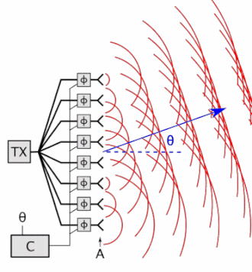
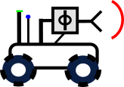
Distributed Beamforming
Objective: Wireless Communication in Presence of Near-peer Adversaries
Increasing Operational Tempo of Future Battles (Requires Autonomy)
Reliability in Complex Environments (e.g., Dense Urban, Indoors, Forests)
Inspiration: Phased Antenna Array
Distributed Robotic Beamforming
Creates coherent signal using multiple antennas
Directional, Controlled Pattern
Covert Comms
Targeted Jamming
Radar
Electronically steerable
Gain is N^2
5 Element Array @2W
= 1 50W Tx
Coherent
Phase Front
Distributed
Across
Robots
Distributed, resilient to single-agent failure
Agile, composed of evolving robot swarm
AI to adapt to environment and near-peer adversary
Phase Controller
N-element Phased Array

Slide 3
Our Contributions (since Dec 21 start)
proposed a novel algorithm: Iteratively Pre-conditioned Gradient-descent for Distributed Beamforming (IPG-DB)
significantly faster than the gradient-descent (GD) based methods
does not rely on receiver feedbacks
does not assume channel fading parameters: robustness to channel noise
Tested on complex simulation frameworks created by ARL.
experimentally compared with 1-bit feedback approach at ARL

Slide 4
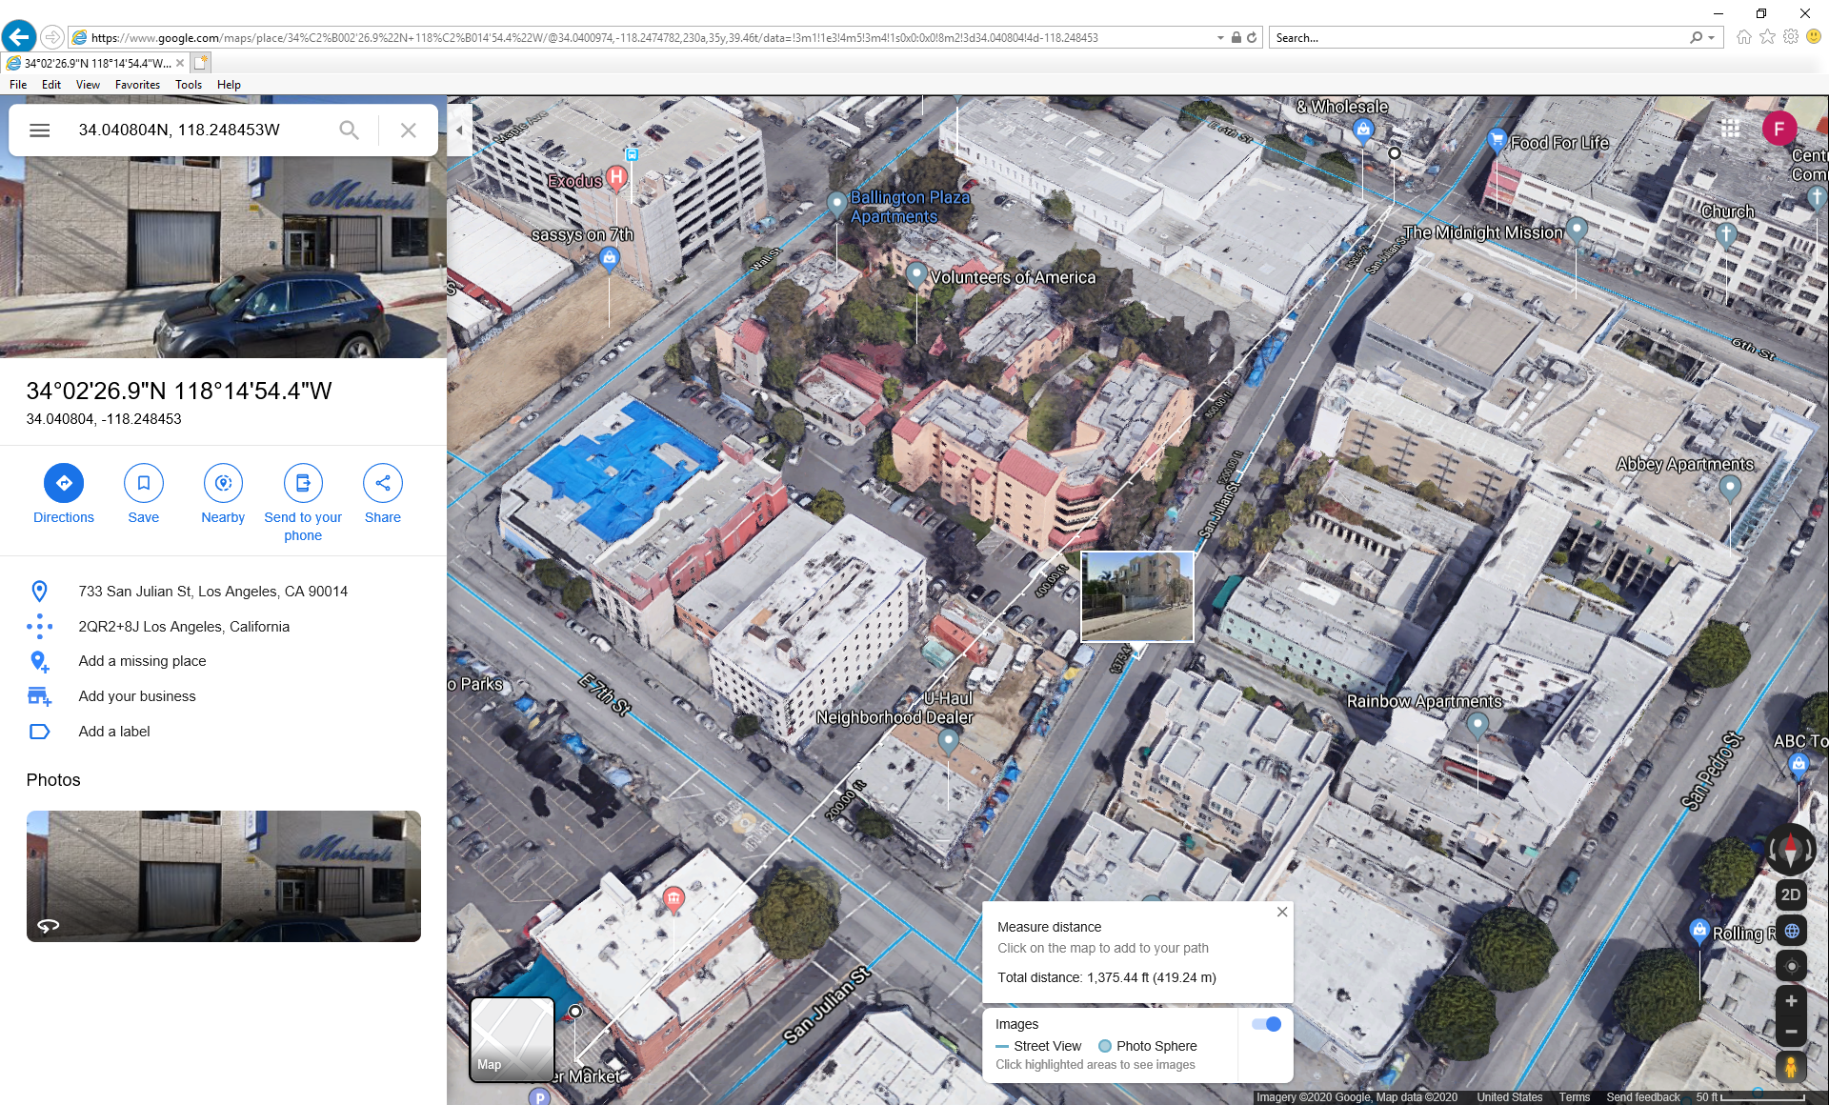
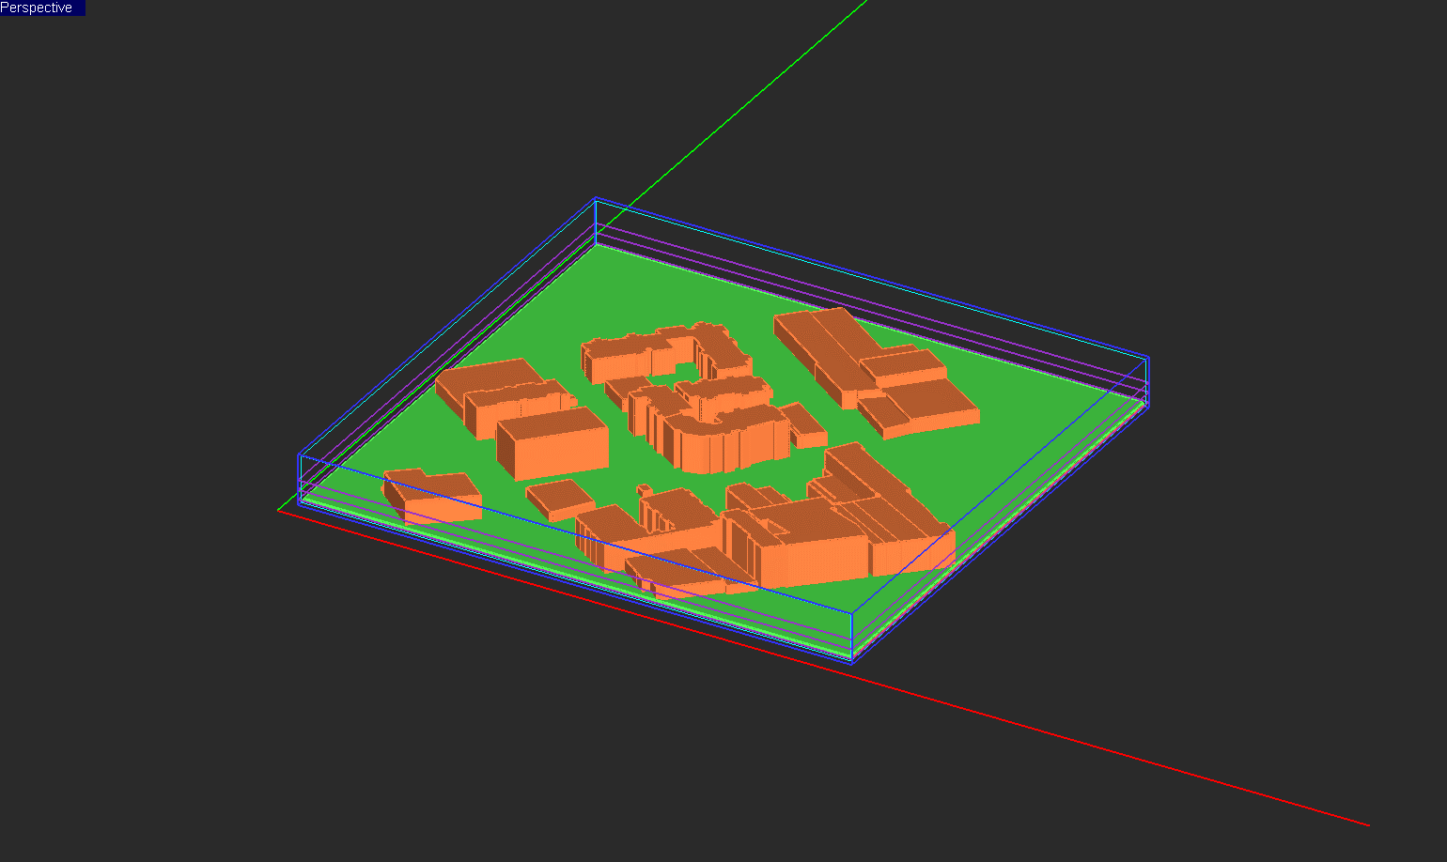
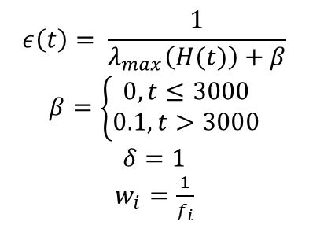
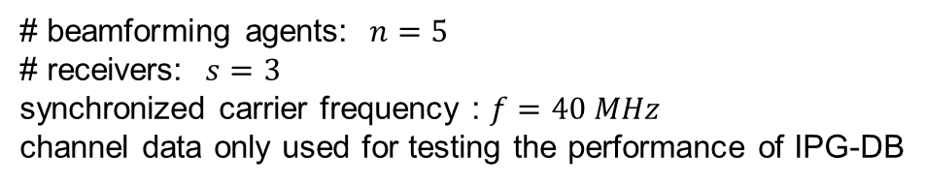
Empirical Results: LA Urban Environment
$$ε\left(t\right)= \frac{1}{λ_{max}\left(H(t)\right)+β}$$
$β=\left\{\begin{aligned}0, t≤3000 \\ 0.1, t>3000\end{aligned}\right.$
$$δ=1$$
$w_{i}=\frac{1}{f_{i}}$
# beamforming agents: $n=5$
# receivers: $s=3$
synchronized carrier frequency : $f=40 MHz$
channel data only used for testing the performance of IPG-DB
A section of Los Angeles
3D CAD model
Physics based simulations using EM.Cube (ARL Data)

Slide 5
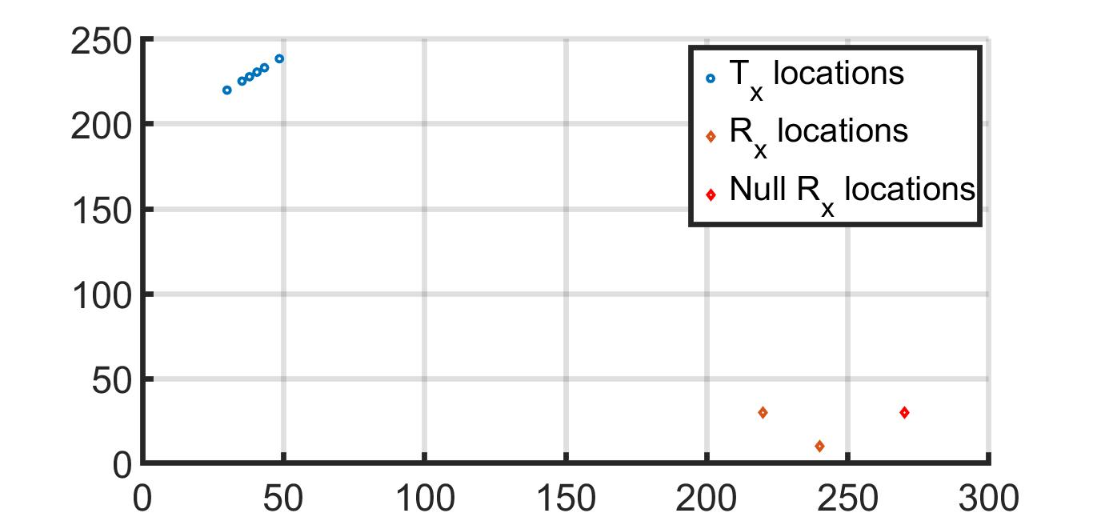
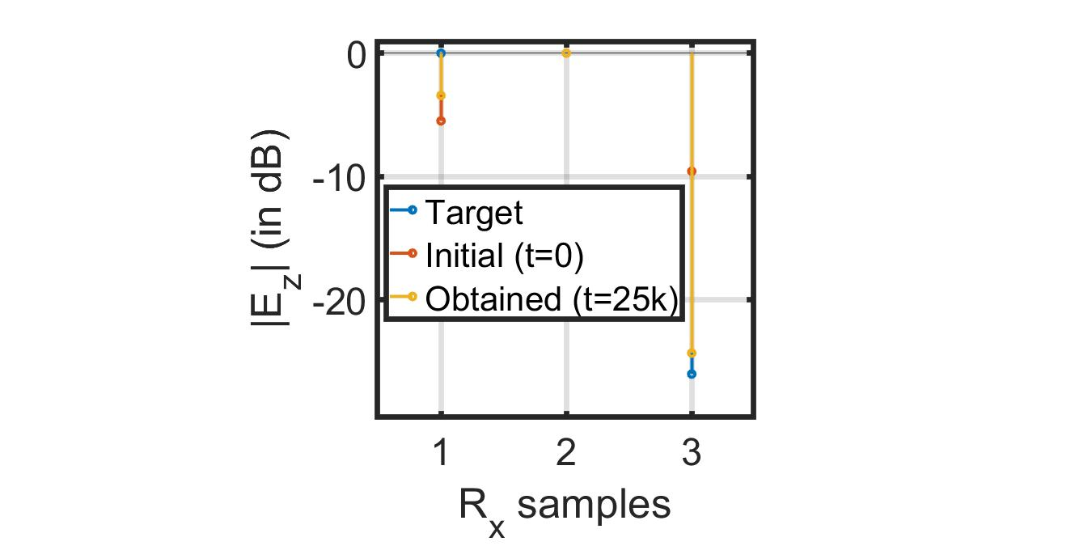
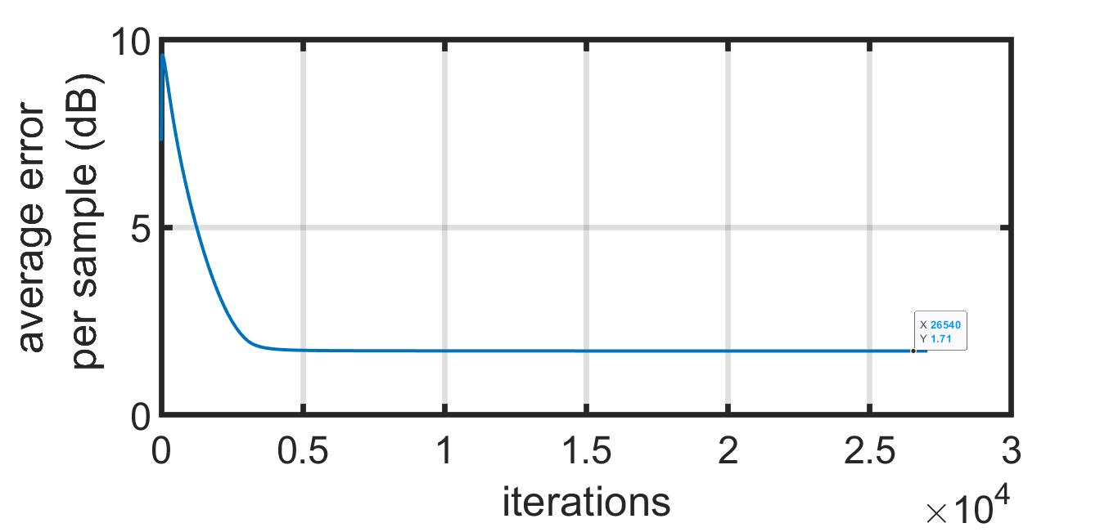
Empirical Results: LA Urban Environment

Slide 6
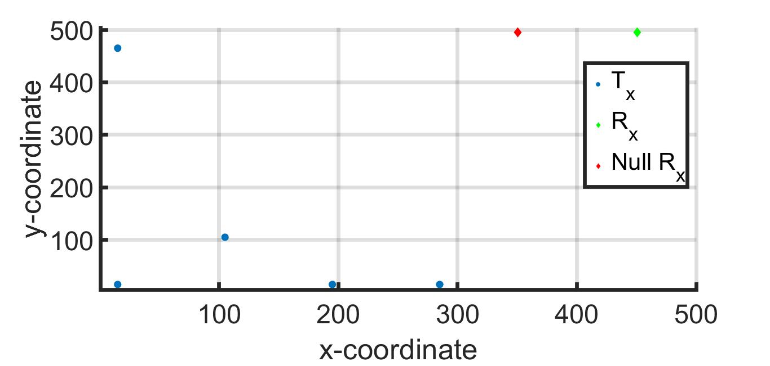
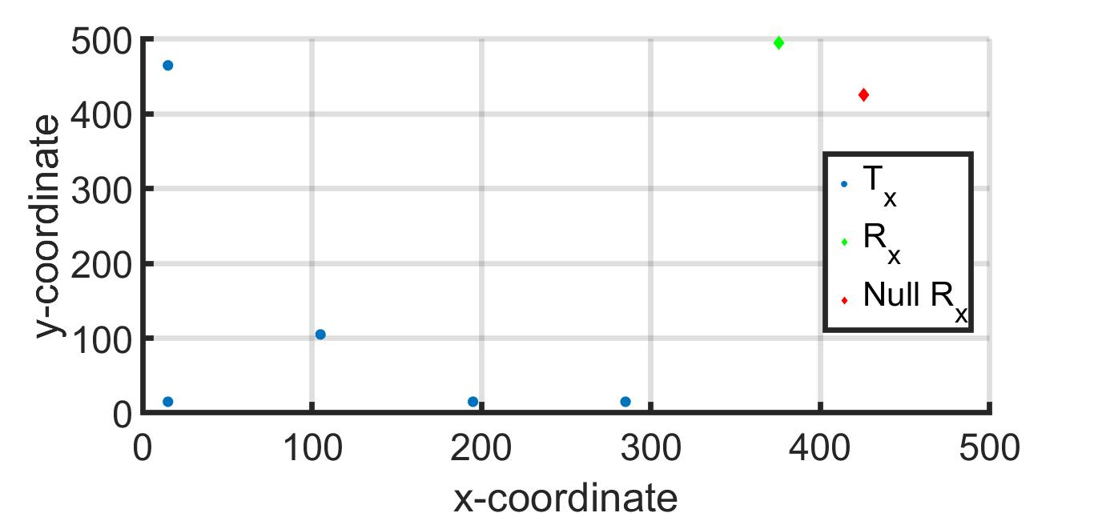
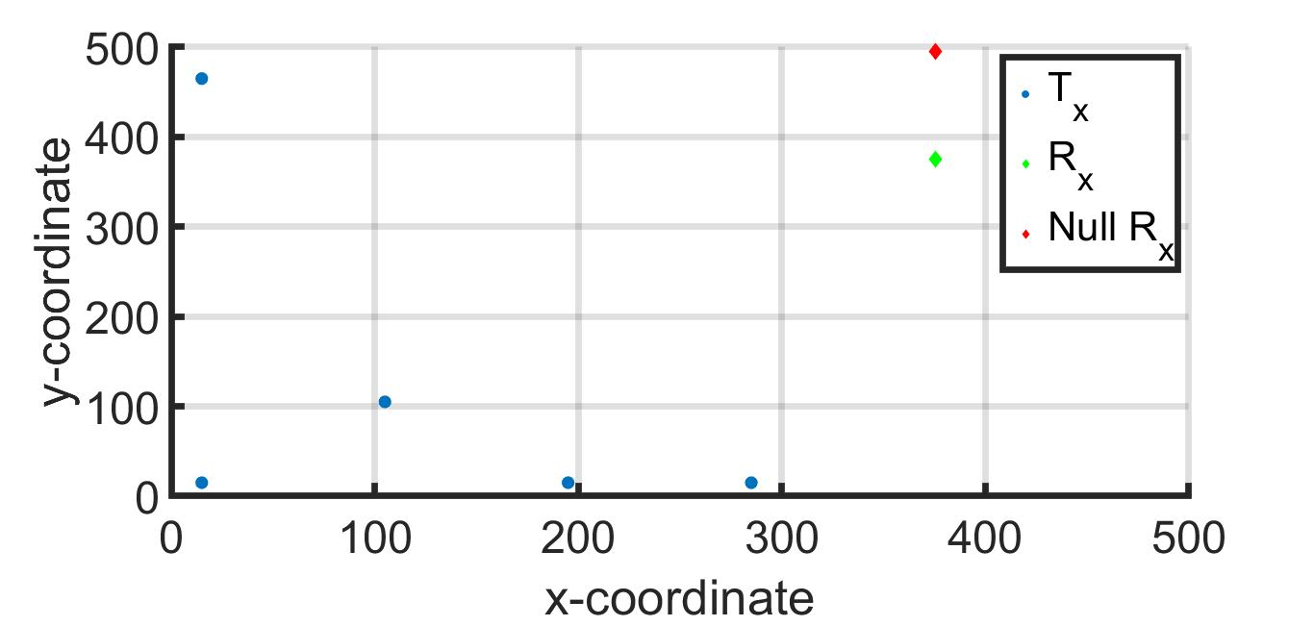
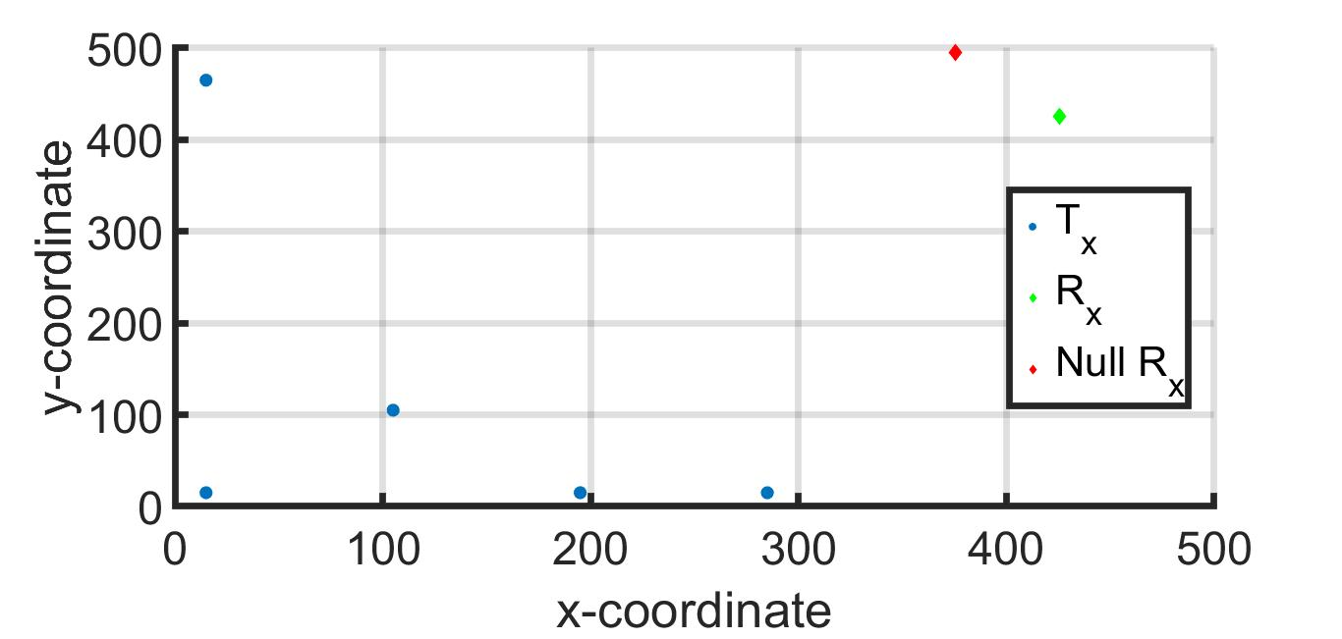
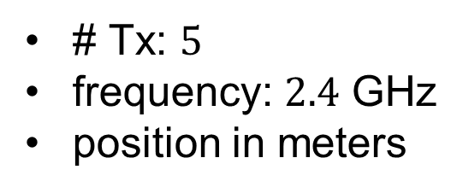
Empirical Results: Boston Urban Environment
# Tx: $5$
frequency: $2.4$ GHz
position in meters

Slide 7
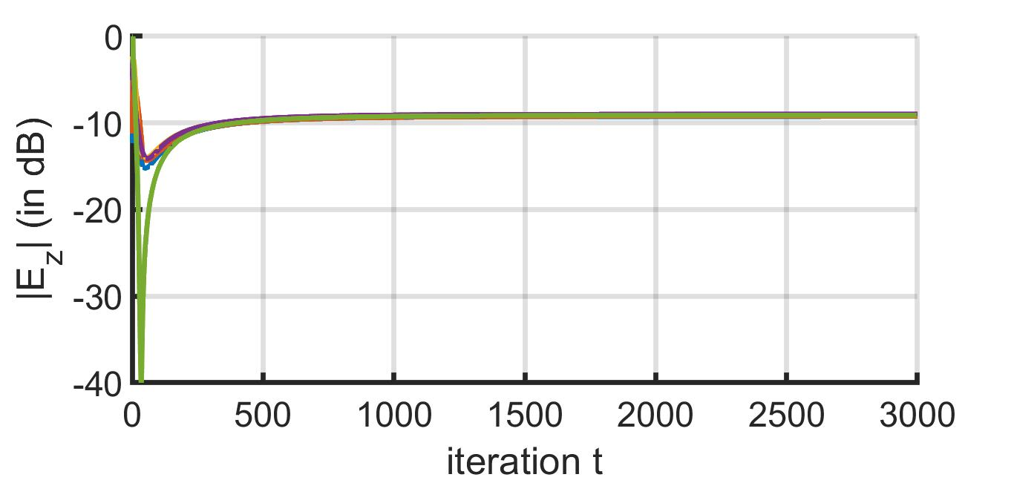
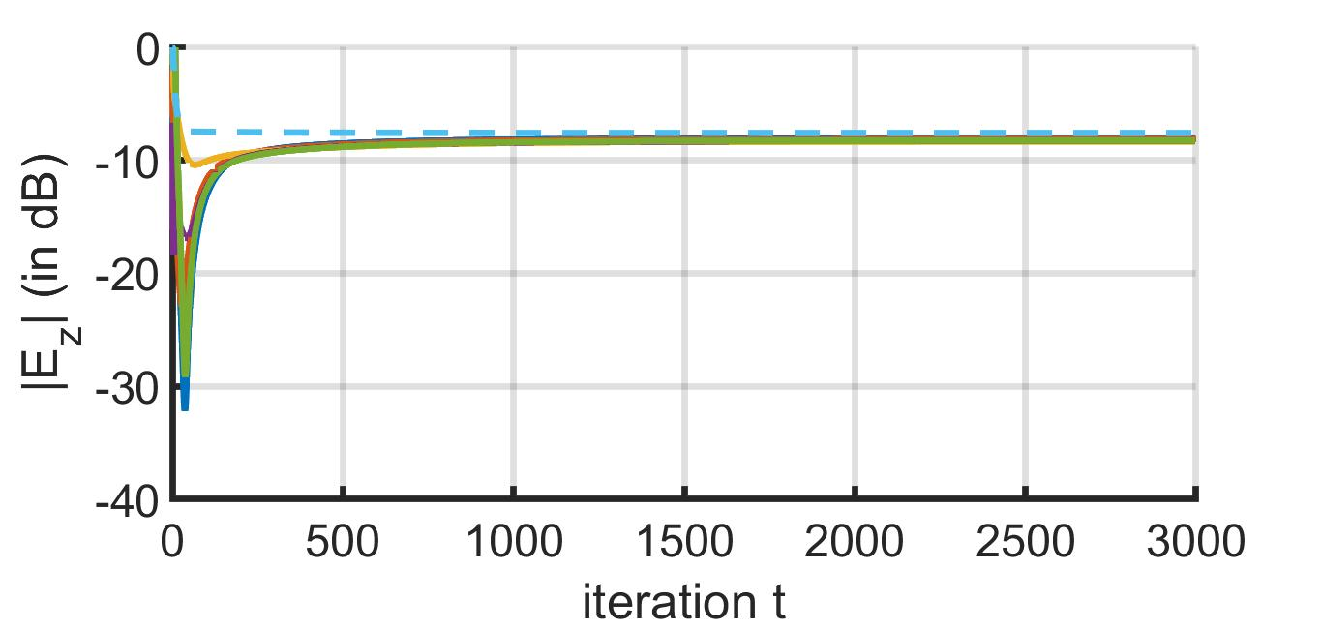
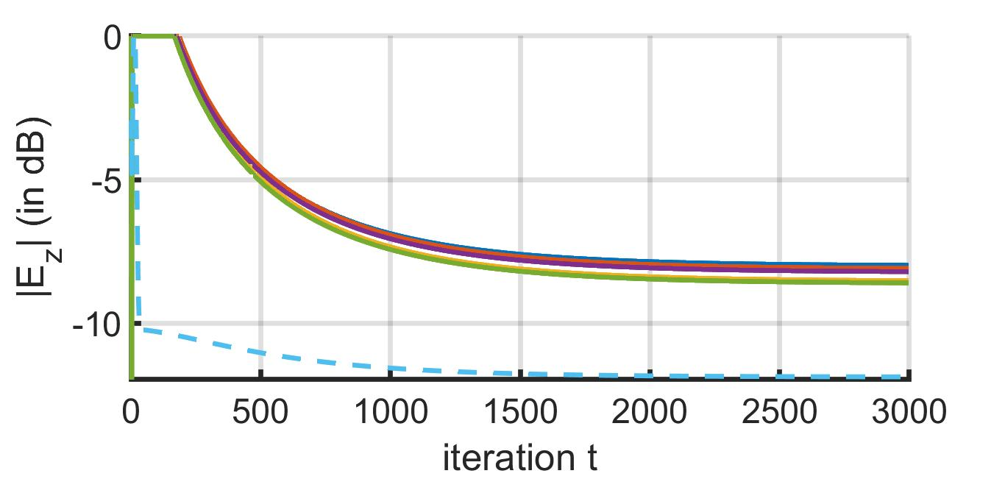
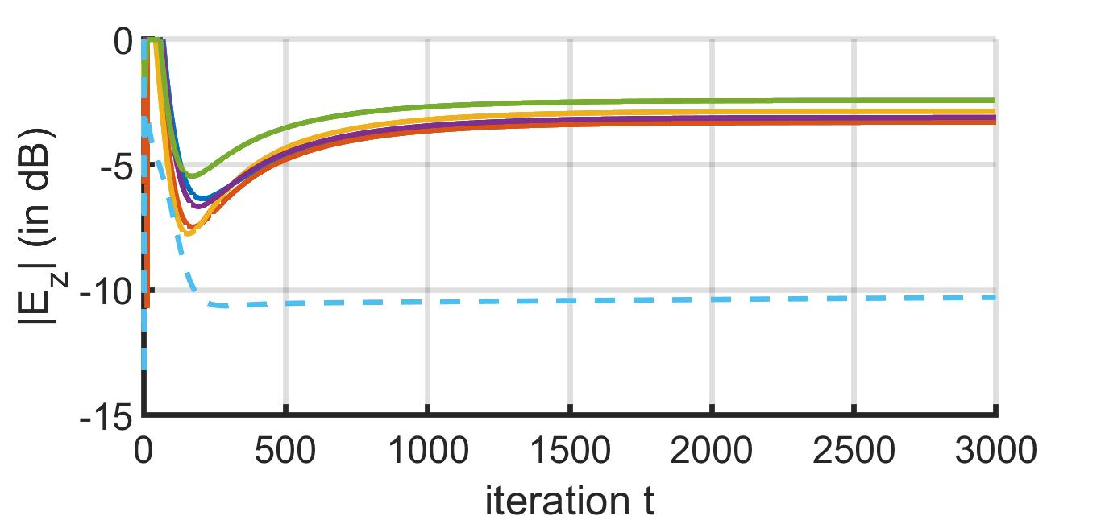
Empirical Results: Boston Urban Environment
RSS at adversary
Verified by Physics-based simulations using EM.CUBE (ARL Data)

Slide 8
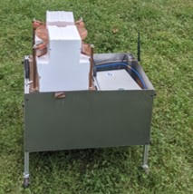
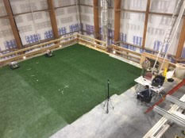
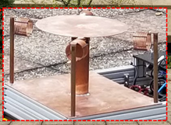
Indoor Experiments at ARL
40 MHz
6 dB – 1-bit feedback
6 dB in ¾ cases, 4 dB in ¼ case – IPG-DB w/o feedback
Tx
Rx
4 different Rx position

Slide 9
Results Obtained and Expected Future Outcomes
proposed a novel algorithm: Iteratively Pre-conditioned Gradient-descent for Distributed Beamforming (IPG-DB)
significantly faster than the gradient-descent (GD) based methods
does not rely on receiver feedbacks
does not assume channel fading parameters: robustness to channel noise
Tested on complex simulation frameworks created by ARL.
experimentally compared with 1-bit feedback approach at ARL
Moving receiver scenario and transmitter framework is under development
Kushal Chakrabarti, Amrit S. Bedi, Fikadu T. Dagefu, Jeffrey N. Twigg, and Nikhil Chopra. Fast distributed beamforming without Receiver Feedback. In 56th Annual Asilomar Conference on Signals, Systems, and Computers. 2022.

